Slide 1
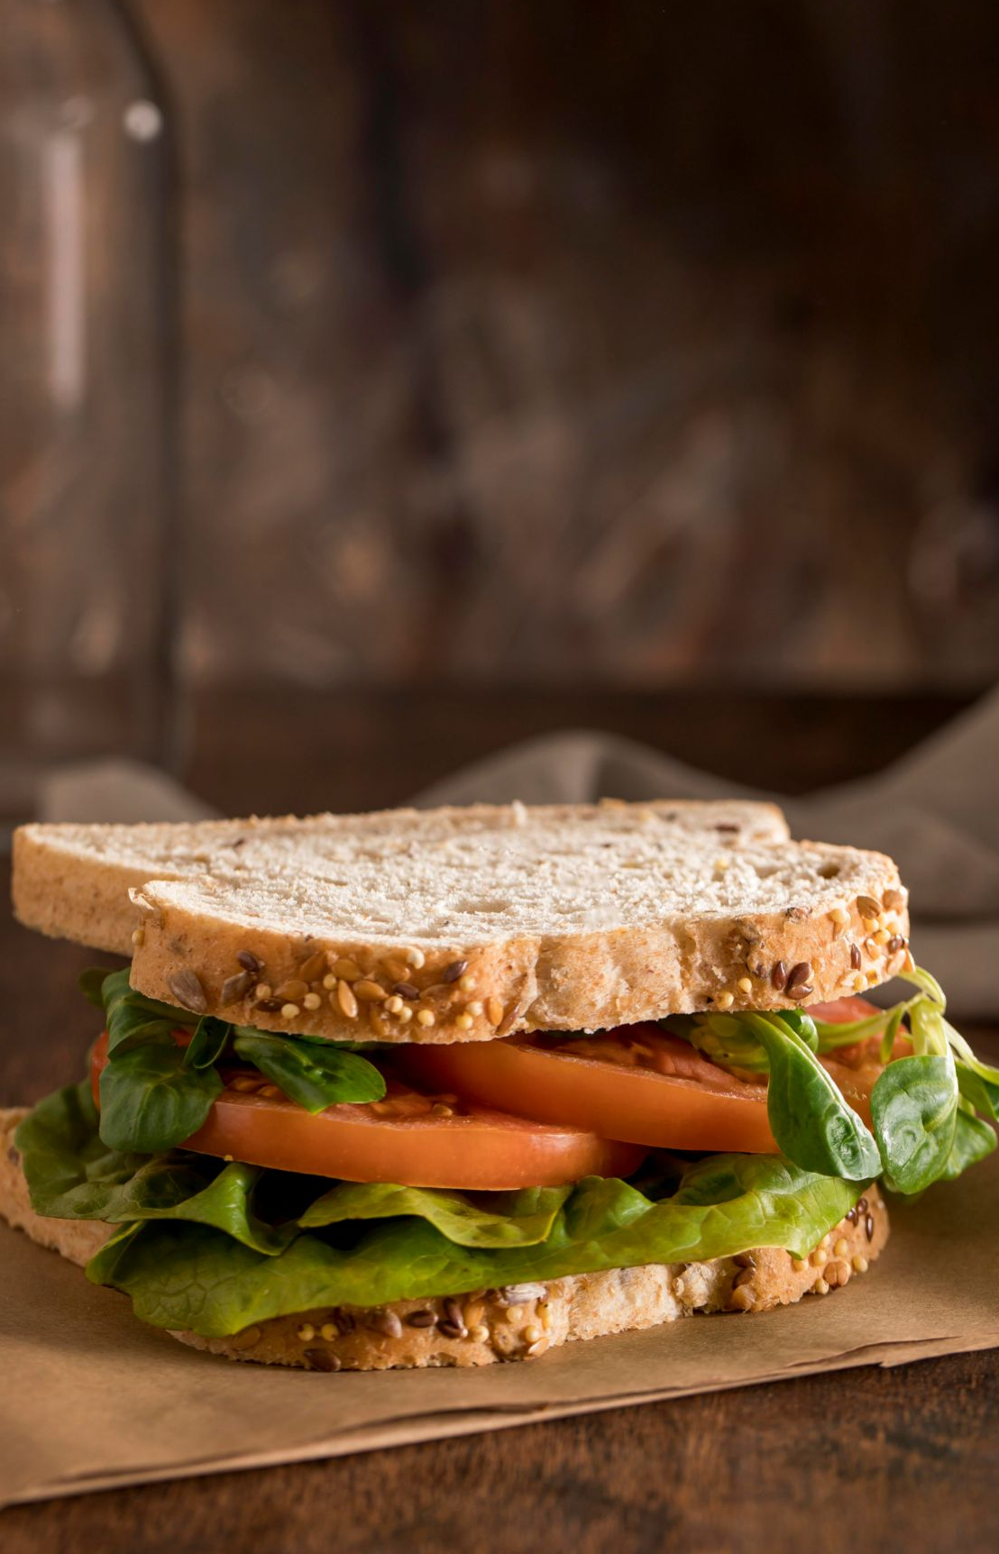
Experiment Data Analysis
MK 726 Final Group Presentation
Team 5
Bella Wen
Owen Xu
Mickey Yeh
Lu Zhang
Shaoran Zhang
Kinjal Vyas

Slide 2
TABLE OF CONTENTS
01
INTRODUCTION
02
EXPERIMENTAL DESIGN
Rewards program overview
Measures and Stimulus
03
DATA CLEAN UP & ANALYSIS
04
TESTS & SUMMARY
Sample description, manipulation check, dependent measures
ANOVA, T-test, Regression analysis and summary

Slide 3
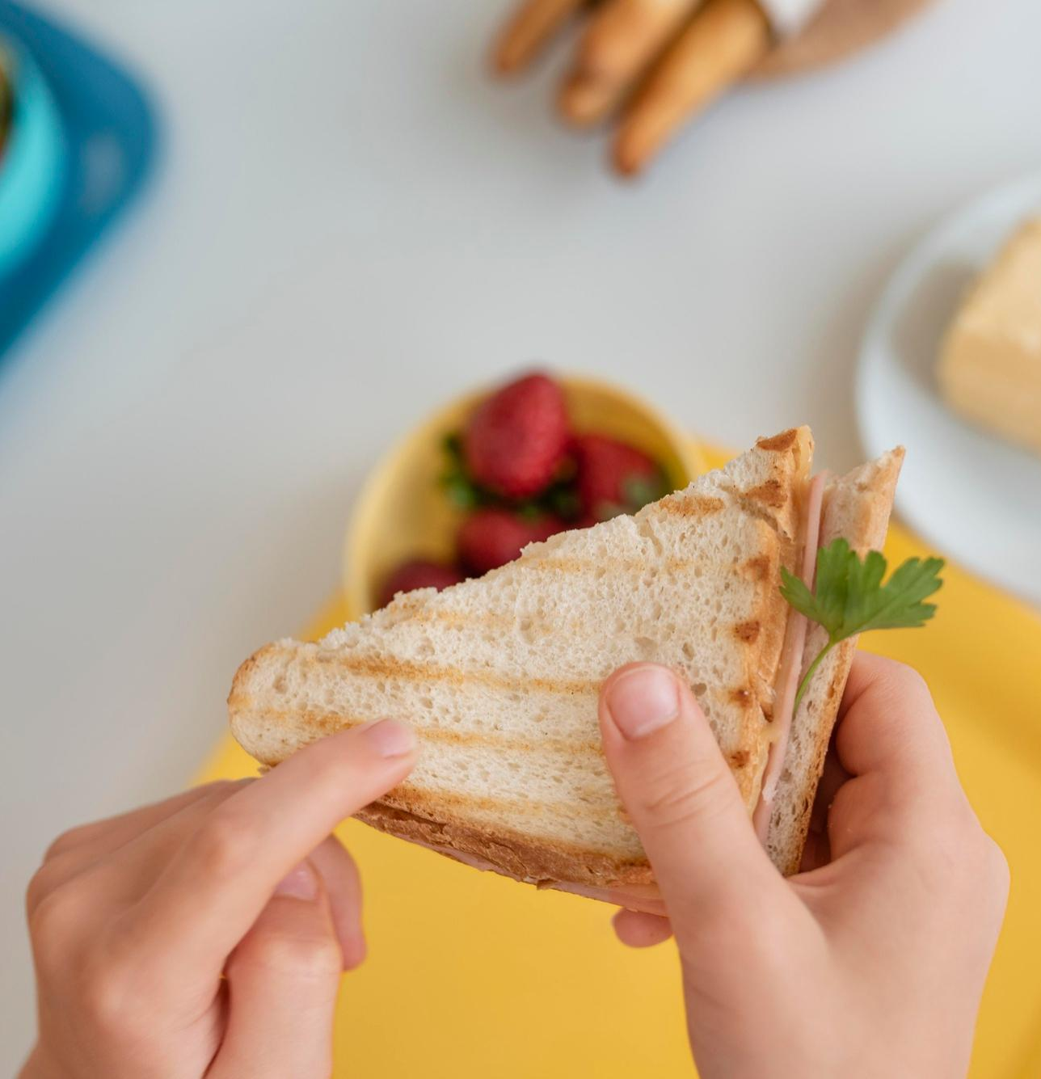
INTRODUCTION
We looked at Subway's loyalty program - Subway MyWay Rewards to understand what they offer currently and how they can improve the program to better retain their regulars

Slide 4
Current Loyalty Program
Program Name: Subway MyWay Rewards Program
Requirement: Earn tokens to get reward. Token value information is-
200 tokens to earn $2 reward (200 tokens = $2 reward)
4 tokens for every $1 in qualifying purchases
Availability: Subway MyWay Rewards is only available at participating stores

Slide 5
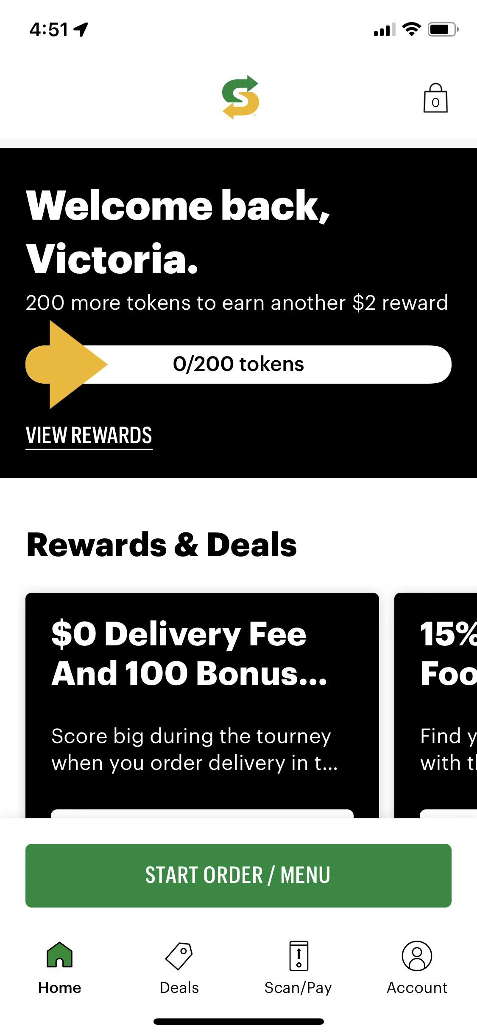
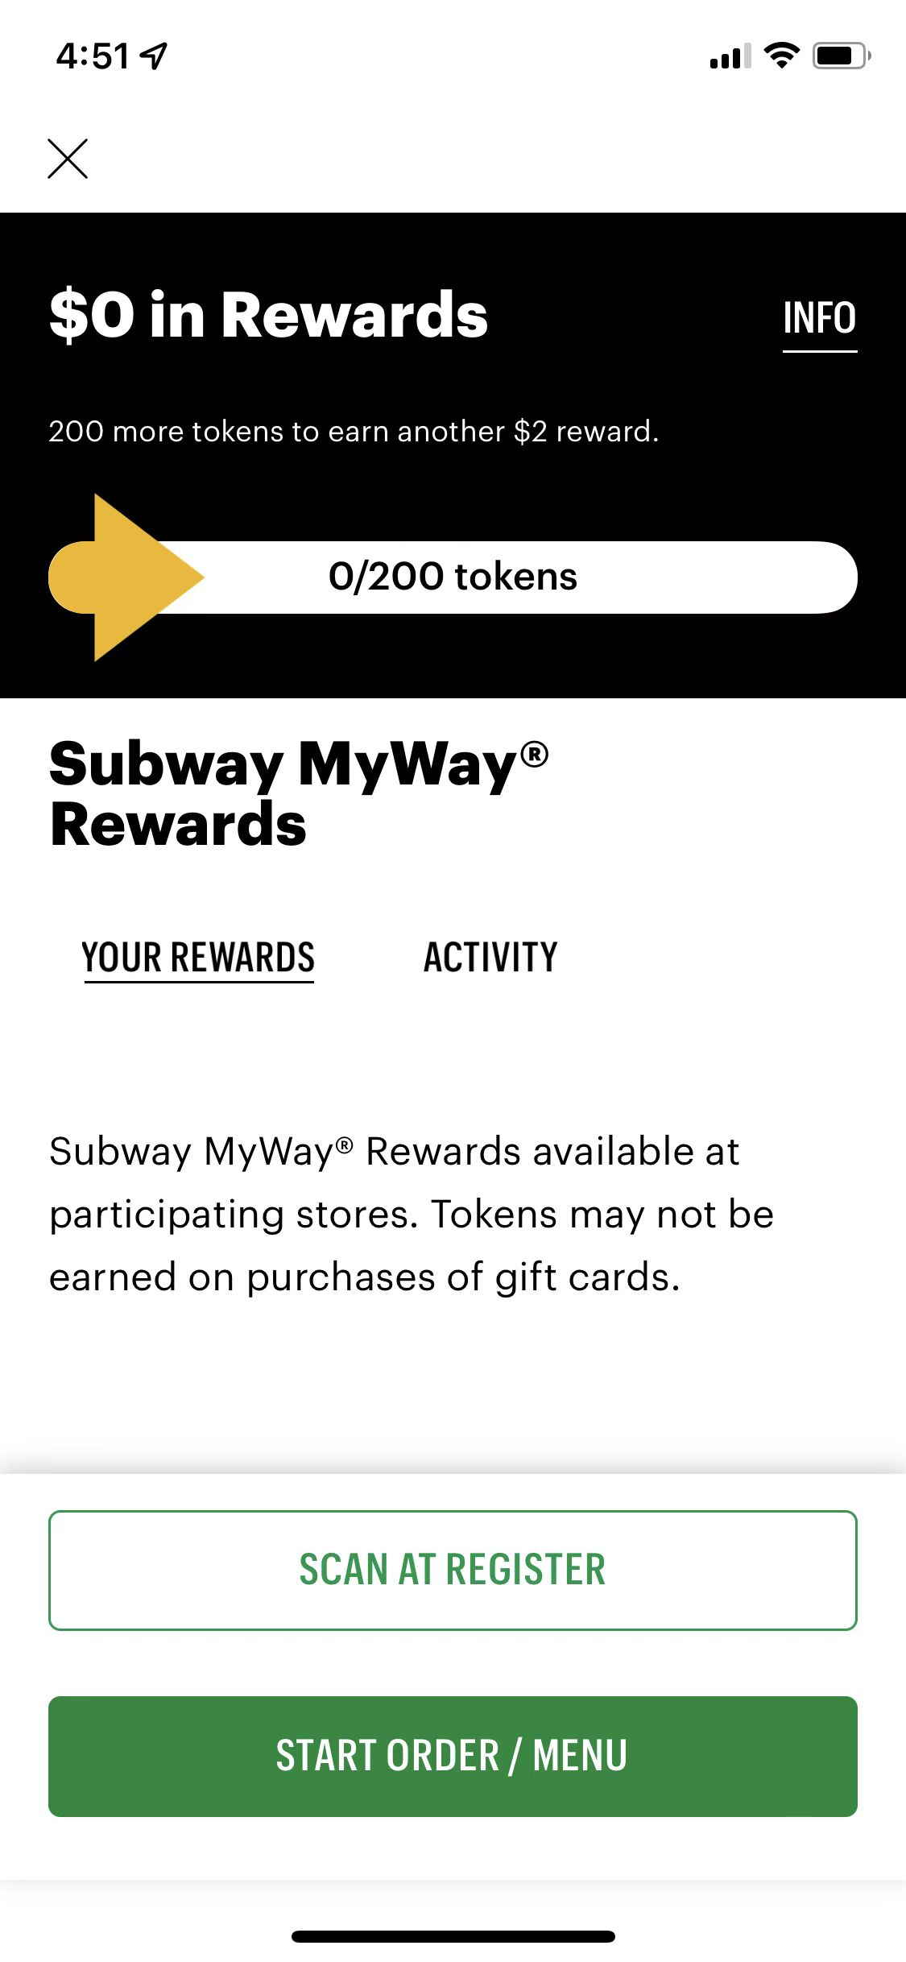
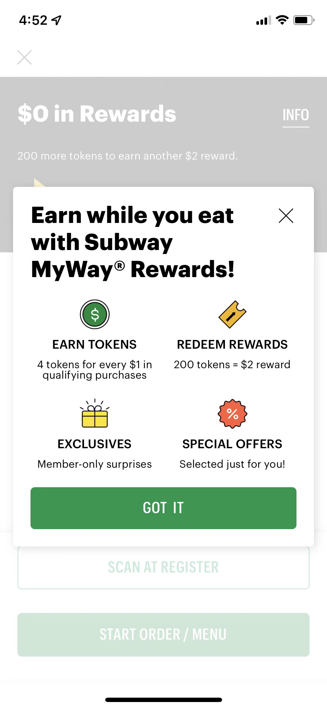

Slide 6
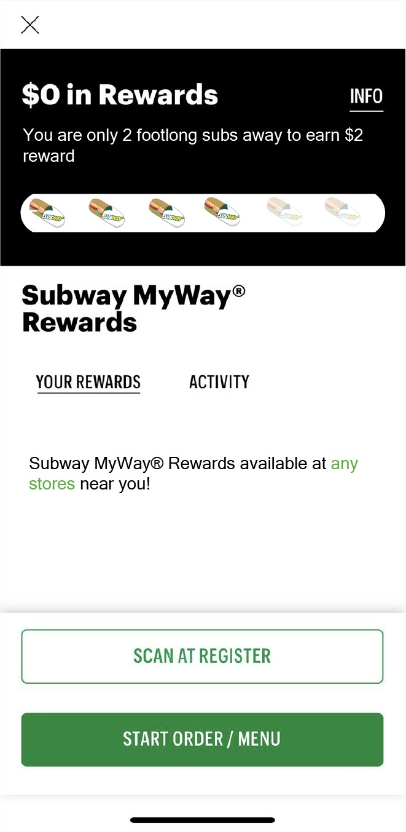
Experimental Design
Independent variable #1:
Ease of mental accounting
[Moderator] Independent variable #2:
Unrestricted store participation​
Notes:
Independent variable 2 is our justification how the two independent variables enhance each other. our justification how the two independent variables enhance each other.

Slide 7
Experimental Design
Independent variable #1:
Ease of mental accounting
[Moderator] Independent variable #2:
Unrestricted store participation​
Notes:
Independent variable 2 is our justification how the two independent variables enhance each other. our justification how the two independent variables enhance each other.

Slide 8
Experimental Design
Independent variable #1:
Ease of mental accounting
[Moderator] Independent variable #2:
Unrestricted store participation​
Notes:
Independent variable 2 is our justification how the two independent variables enhance each other. our justification how the two independent variables enhance each other.

Slide 9
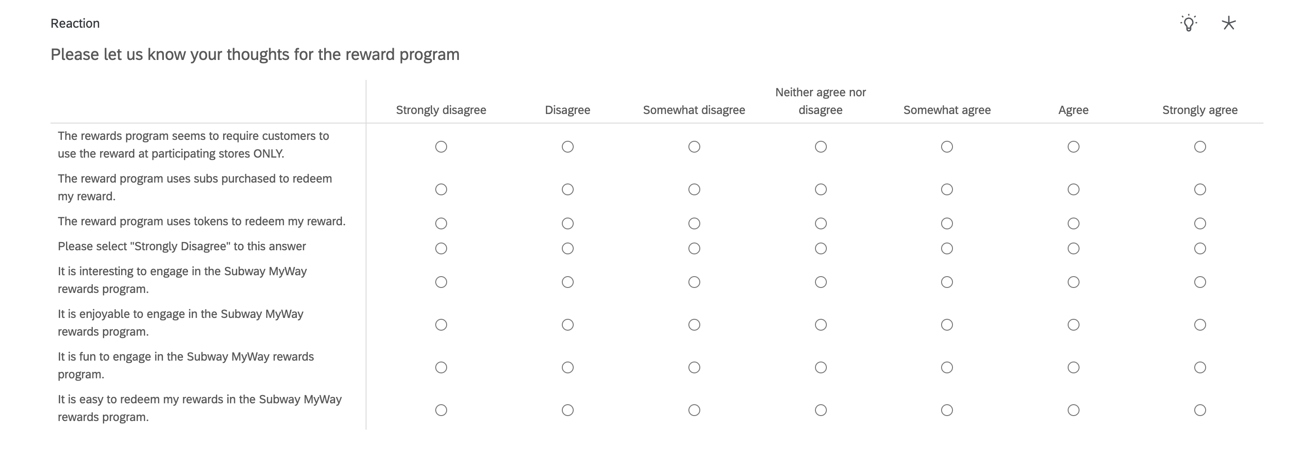
Experimental Design & Measures
Dependent variable: Intrinsic motivation

Slide 10
Experimental Design & Measures
Dependent variable: Intrinsic motivation
Outcome Variables (Likert scale 1-7 points)​

Slide 11

Experimental Design & Measures
Manipulation check:
Using "6 footlong subs away" instead of 136/200
"Redeem at any store" instead of "participating stores"
Notes:
This will lead to ease of mental accounting for reward members. The reward will also be broad in the sense that we will give them $2 for every 6 footlong subs they purchase and they can choose to spend this however they want. We are also giving them autonomy by letting them redeem the reward at any store they prefer.

Slide 12
Other Measures
Attention Check
Demographics
Gender
Age
Zip Code
Education Level
Income Level
Attitudinal loyalty to Subway
Subway is the first brand I look for, if I want to have sandwich.
I always go to Subway, if I want to have sandwich.
I usually go to Subway, if I want to have sandwich.
Overall, I am loyal to Subway.

Slide 13
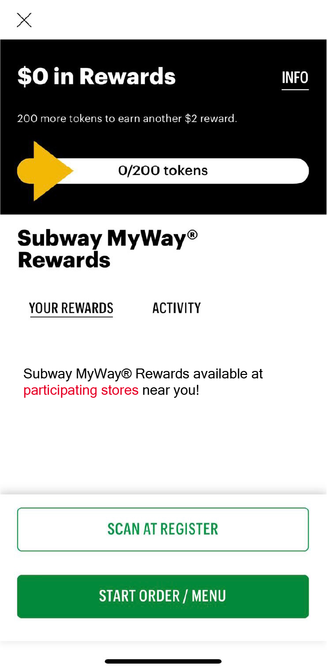
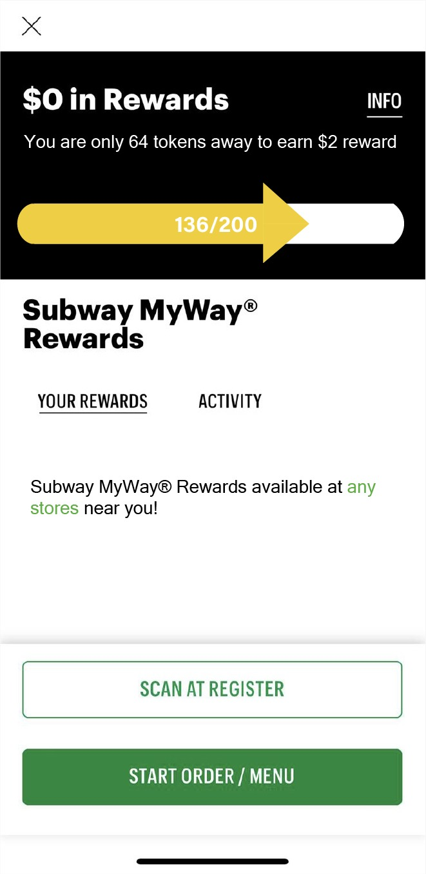
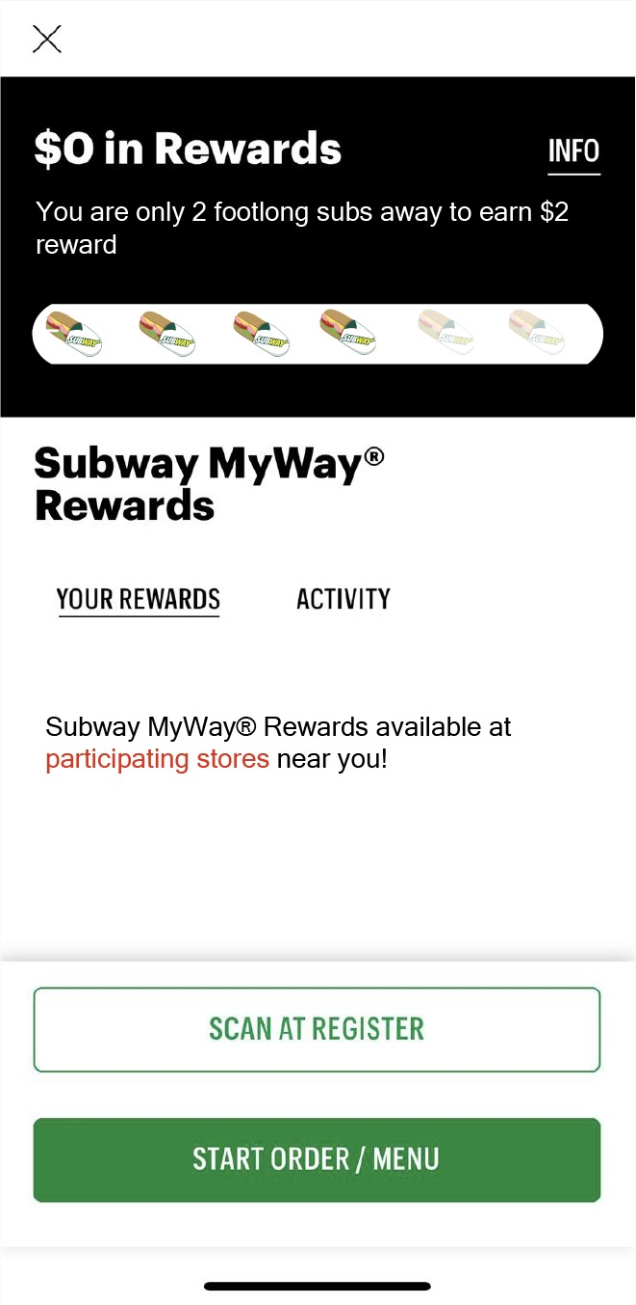

Stimulus for Survey
Original version
Proposed version
200 more tokens earn another $2 reward
64 more tokens earn another $2 reward
No autonomy, without
ease of accounting
Autonomy, without
ease of accounting
No autonomy, with
ease of accounting
Autonomy, with
ease of accounting
Notes:
2nd picture – hard to figure out the difference (respondents won't put much effort) - highlight any (bold, red or caps)
Highlight participating store as well (make it red, bold, caps or change font size)
Highlight 200 more tokens or only subs part
Update subs to 15

Slide 14
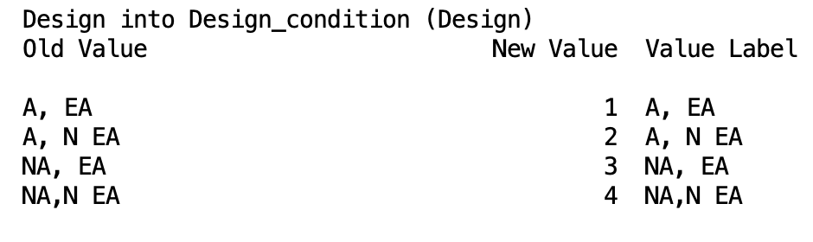
Data Clean Up
After removing preview responses and keeping only the respondents that passed attention check. We had 245 total responses out of the initial 300 that we received.
We changed the design label into Design_condition.
Value label explanation:
A, EA – use subs at any store
A, NEA - use token at any store
NA, EA - use subs at participating stores only
NA, NEA - use token at participating stores only
A - autonomy
NA - no autonomy
EA - ease of accounting
NEA- without ease of accounting

Slide 15
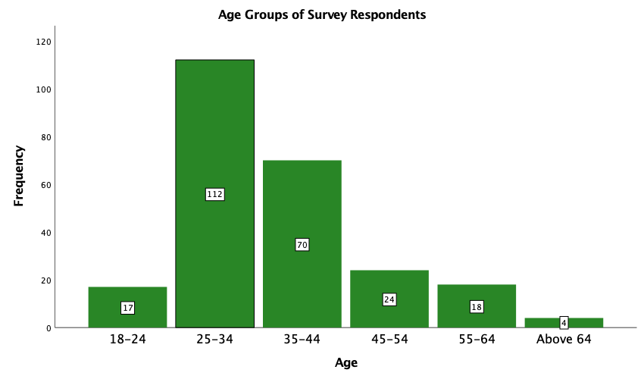
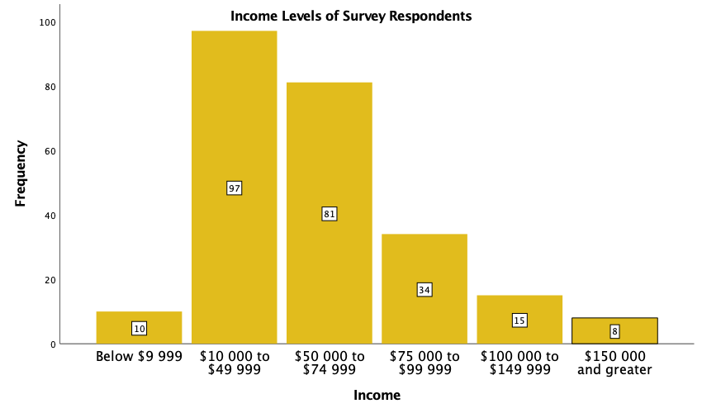
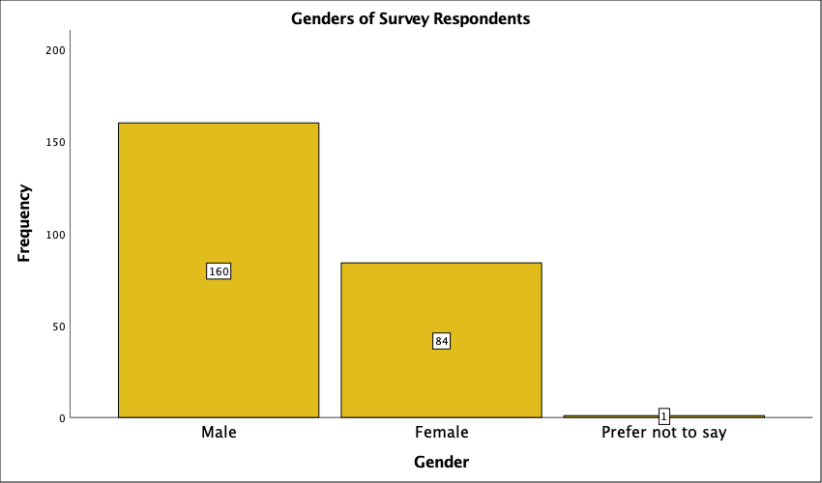
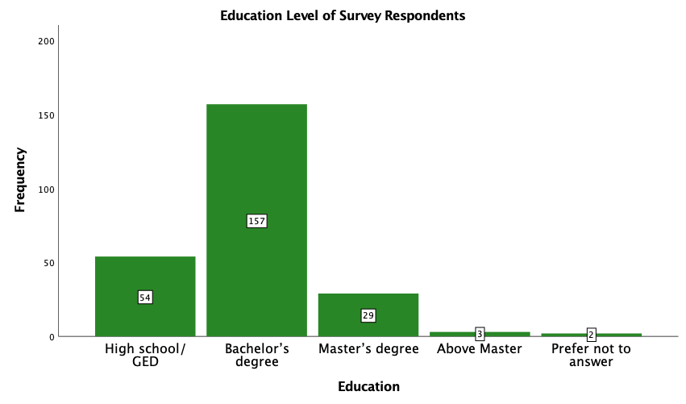
Sample Description
Notes:
Here are the demographics for our 245 survey respondents:
Majority age group ranged from 25-34 (nearly 45%)
Income levels ranged from $10K - $99K (35% from $10K - 49$)
Gender distribution skewed to males (57%)
Education level ranges from high school graduates to Master's degree (56% from Bachelor's degree)

Slide 16
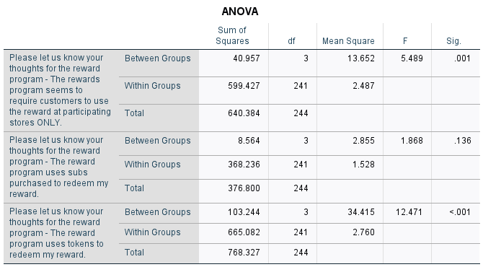
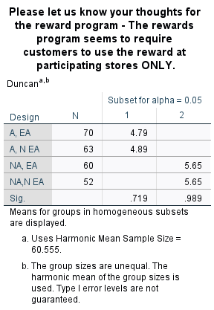
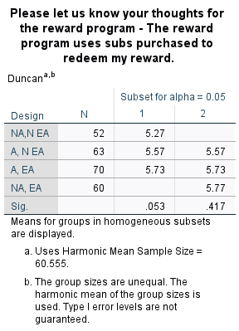
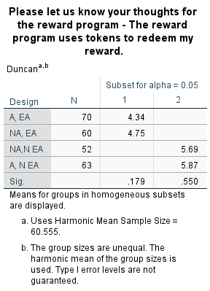
Manipulation Checks
The rewards program seems to require customers to use the reward at participating stores ONLY. --Passed
The reward program uses subs purchased to redeem my reward. --Failed
The reward program uses tokens to redeem my reward. --Passed
A, EA – use subs at any stores
NA, EA - use subs at participating stores only

Slide 17
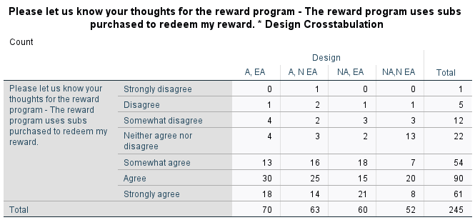
Closer Look Crosstab
Upon closer inspection, we learned that we had respondents who didn't see subs in the stimuli but reported "Strongly agree" to this question. To get accurate results, we decide to remove these records.

Slide 18
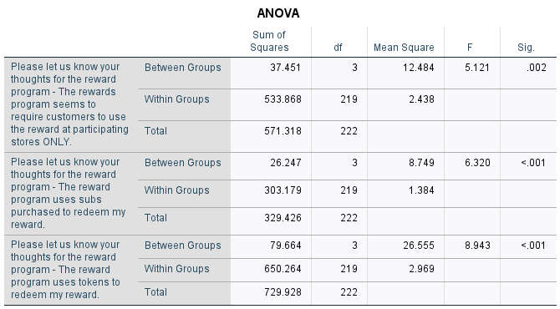

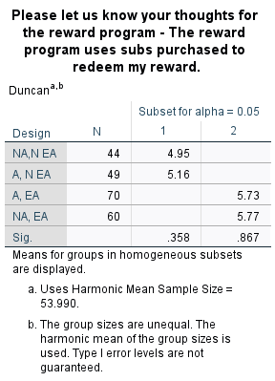

Double Check After Removing Invalid Records
After removing these 22 invalid records, all respondents passed the manipulation checks.

Slide 19
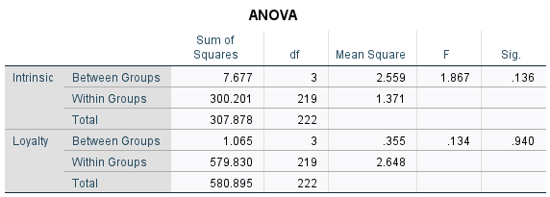
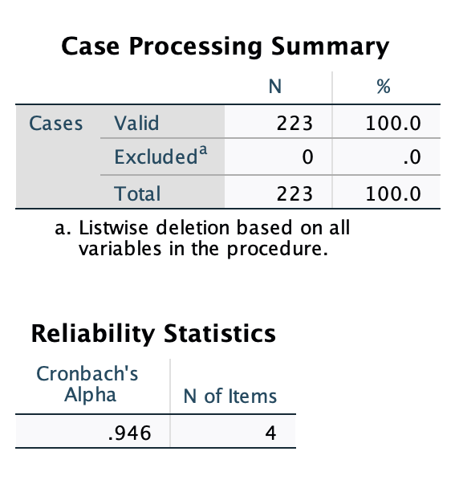
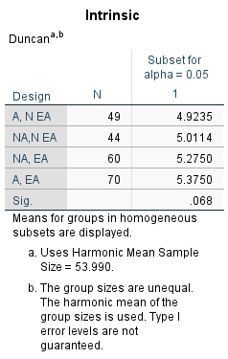
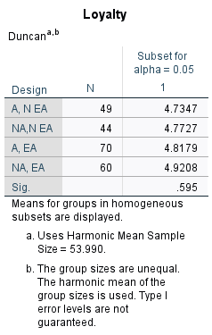
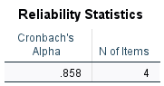
Main Analysis
Reliability of dependent measures:
ANOVA Test:
Results of dependent variables across design conditions:

Slide 20
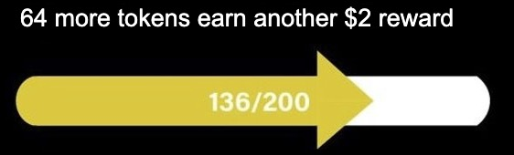
Merging Designs
This is how we merged our 4 different designs into 2 different sub-groups:
(1) Without Ease of Accounting and (2) With Ease of Accounting
Before Merge – 4 Designs
After Merge – 2 Designs
64 more tokens earn another $2 reward
Without
Ease of
Accounting
With
Ease of
Accounting

Slide 21
Merging Designs
Before Merge – 4 Designs
After Merge – 2 Designs
After the merge to (1) Without Ease of Accounting and (2) With Ease of Accounting, the intrinsic motivation turned out to be significant and showed a clear pattern between the 2 different groups.

Slide 22
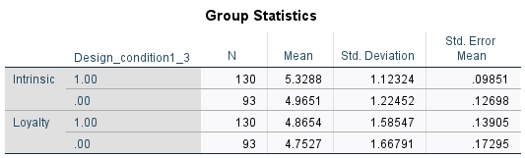
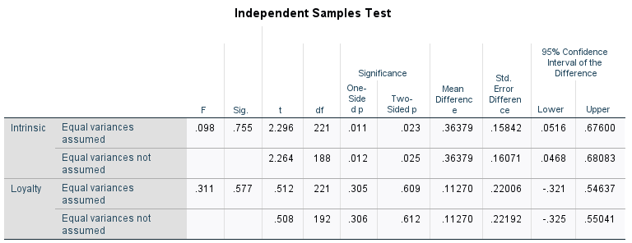
Independent Sample T-test
p-value: 0.023
Intrinsic motivation is different between these two groups.
mean: 5.3288, 4.9651
Design of ease of accounting improves the intrinsic motivation.

Slide 23
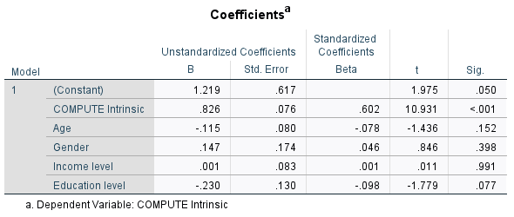
Correlation Analysis
Sig: < .001
Coefficient: .803
Intrinsic motivation is significant and positive to customer loyalty.

Slide 24
Summary
300 222
Reliability of intrinsic motivation: .946
Reliability of Loyalty: .858
2 groups of ease of accounting and non-ease of accounting
T-test: Design of ease of accounting improves the intrinsic motivation.
Multi-linear regression: Intrinsic motivation is significant and positive to the loyalty of customer.
Using our design of the little sub scale to replace the original token calculation will help increase customer's intrinsic motivation to participate in the rewards program, hence improving customer loyalty.
64 more tokens earn another $2 reward
Notes:
- Add the OG design and new final design that worked best
- Update second bullet
- Make slide less wordy

Slide 25
THANK YOU! QUESTIONS?

Slide 26
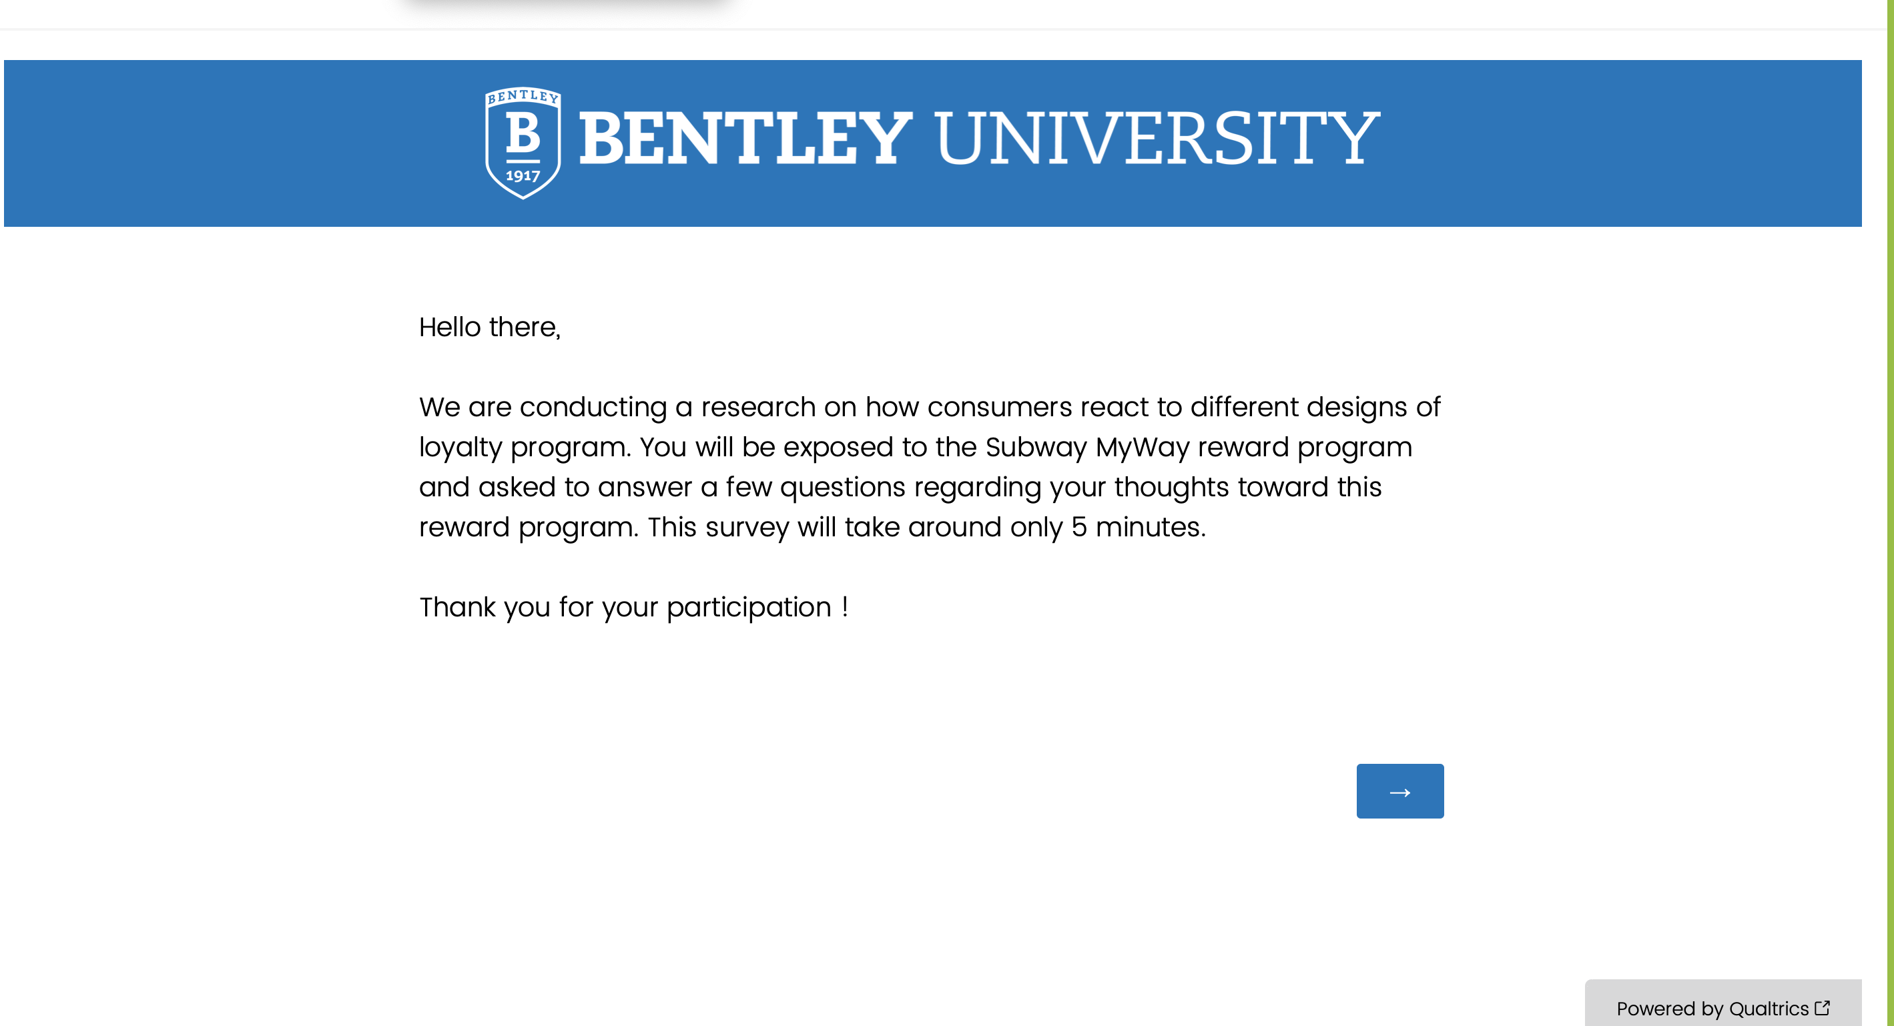
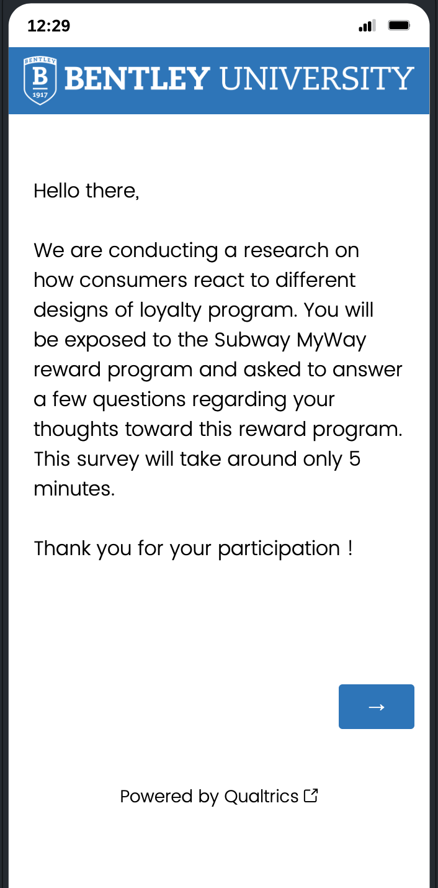
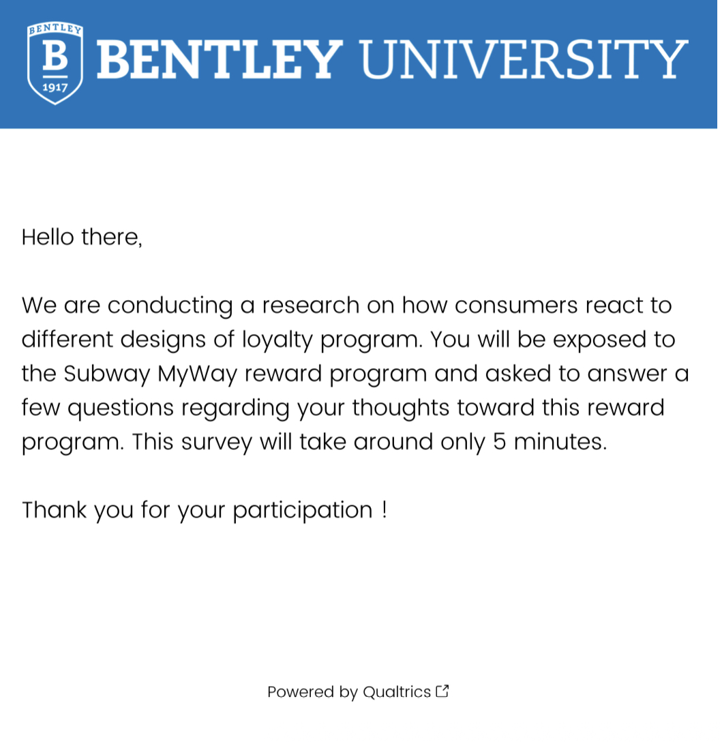
Qualtrics Survey
Here's the embedded link to our survey:
https://bentley.co1.qualtrics.com/jfe/form/SV_8GKWvxo2IqUkMfA

